Slide 1

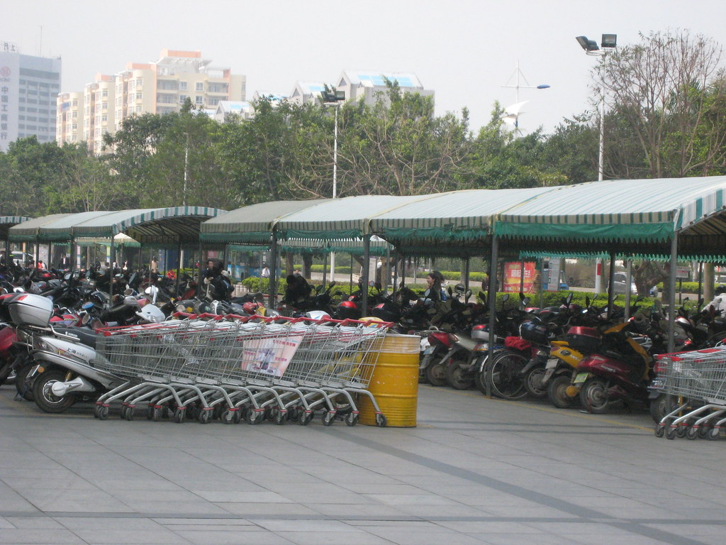
Vehicle Rental Service System
Powered by FastAPI, MongoDB &
JWT Authentication

Slide 2

Abstract
The Vehicle Rental Service is a web-based system designed to simplify the process of renting vehicles online.
Customers can register, browse available vehicles, and book rentals.
Admins can manage vehicles, pricing, and users.
The system ensures secure authentication using JWT tokens.
Vehicle Rental Service System

Slide 3
INTRODUTION
Renting vehicles is a common need for daily commuters and travelers.
Manual rental systems are prone to delays and inefficiencies.
This project introduces an AI-driven, secure, and efficient rental platform.
Vehicle Rental Service System

Slide 4
Objectives
Provide a secure user registration and login system.
Implement role-based access control (Customer, Admin).
Allow admins to add, update, and delete vehicles.
Allow customers to browse and rent vehicles online.
Ensure data security using hashed passwords & JWT authentication.
Vehicle Rental Service System

Slide 5
Project Overview
A comprehensive system designed to power a vehicle rental platform where customers can seamlessly rent cars or bikes based on availability and customized rental plans. The application allows administrators to efficiently manage the fleet by adding, updating, or removing vehicle listings, configuring pricing plans (hourly, daily, weekly), and controlling real-time availability. End-users can browse available vehicles, create new rental bookings, modify existing reservations, or cancel upcoming trips through a smooth booking workflow. The system also handles validations, booking conflicts, and status tracking to ensure a reliable, scalable, and user-friendly rental experience.
Vehicle Rental Service System

Slide 6
System Requirements
Software Requirements:
Operating System : Windows 10/11
Programming Language: Python 3.12+
Framework : FastAPI
Web Server : Uvicorn
Database : MongoDB
Version Control : Git (for source code management)
IDE / Editor : VS Code

Slide 7
Hardware Requirements:
Minimum: Dual-core CPU, 4 GB RAM, 20 GB Storage
Recommended: Quad-core CPU, 8 GB RAM, 50 GB Storage

Slide 8
System Design
User Roles:
Guest → Register / Login
Customer → Browse & Rent vehicles
Admin → Manage vehicles & users
Modules:
Authentication (JWT-based)
User Management
Vehicle Management
Rental Booking (Future Scope)
Vehicle Rental Service System

Slide 9

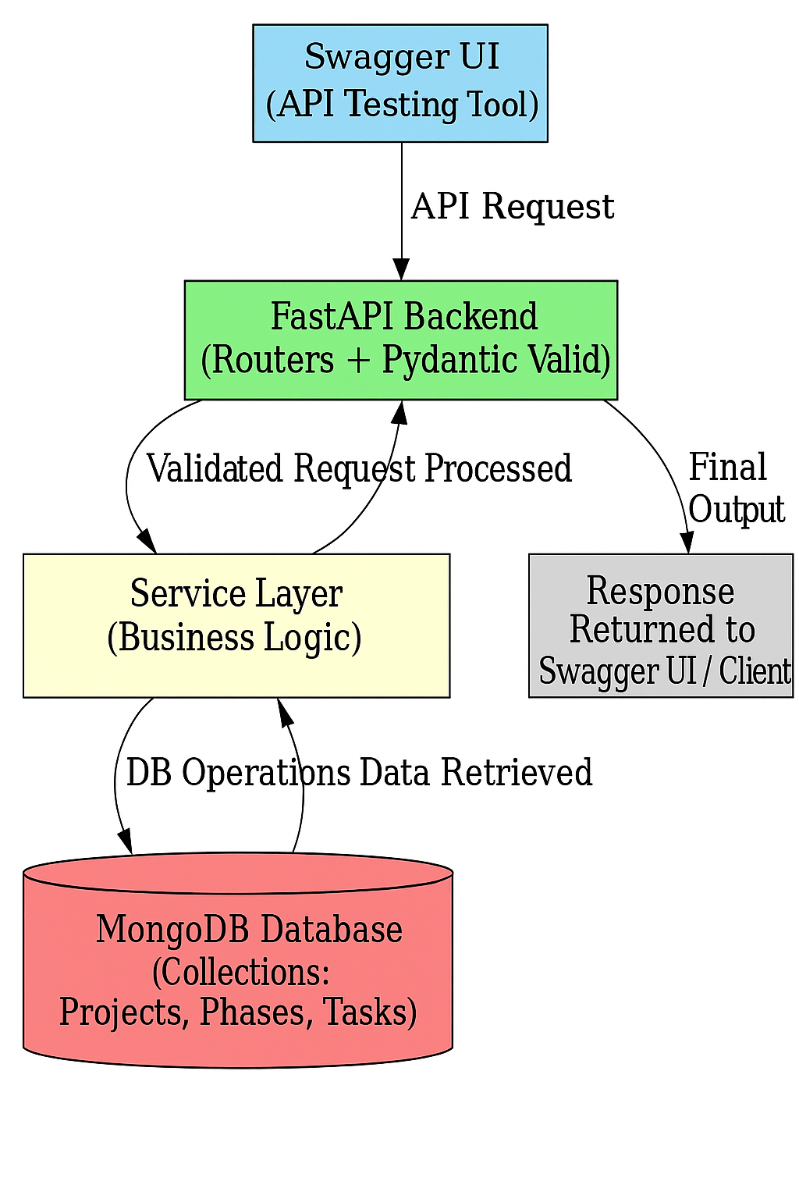
Architecture
Figure 1: Layered Architecture Vehicle Rental Service System
Vehicle Rental Service System

Slide 10
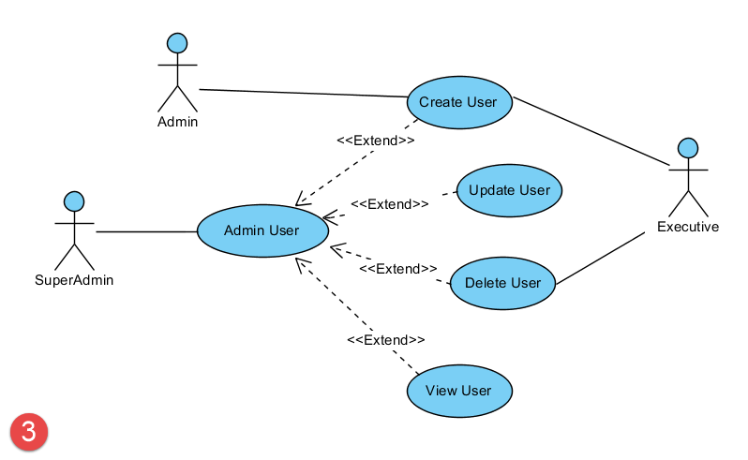
Database Design
Collections:
1. Users:
_id, name, email, hashed password, role
2. Vehicles:
_id, type, model, plate number, price per hour, available
Vehicle Rental Service System

Slide 11
Features
User Registration & Login
Password Hashing (bcrypt)
JWT Authentication (token-based login)
Admin: Add / Update / Delete vehicles
Customer: View available vehicles
Role-based security (Admin vs Customer)
Future Scope: Rental bookings, Payment Integration, Notifications
Vehicle Rental Service System

Slide 12
Conclusion
This project lays the foundation for a scalable vehicle rental platform.
Ensures security, efficiency, and usability.
Can be expanded into a complete SaaS solution in future.
Vehicle Rental Service system

Slide 13
Vehicle Rental Service System

Slide 14
Thank You

